Slide 1
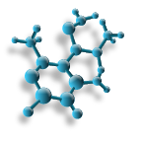
PTA/OTA 106 Unit 2 Lecture 4

Slide 2
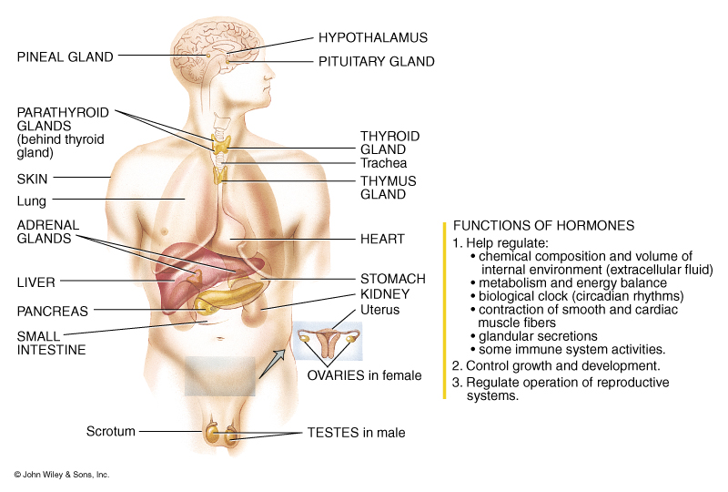
Introduction to the Endocrine System

Slide 3
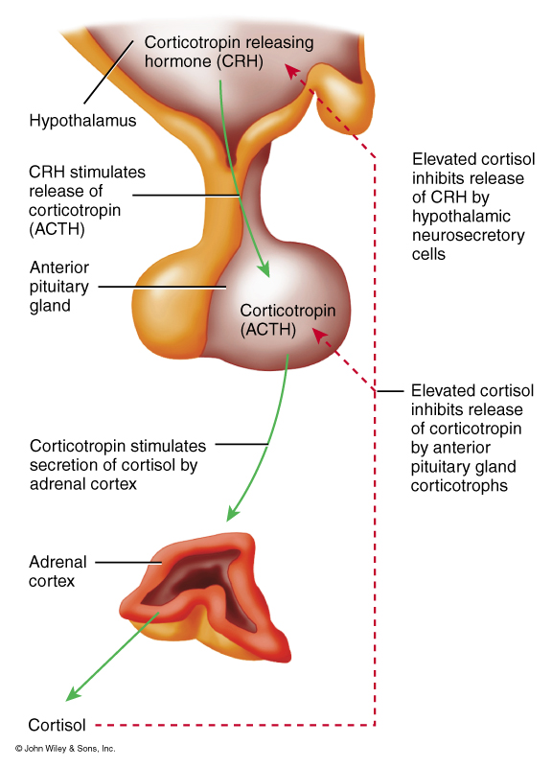
Anterior Pituitary or Adenohypophysis
Corticotrophs
Adrenocorticotropic hormone (ACTH)
Hypothalamic Control
Corticotropic releasing hormone (CRH)
Target Tissue
Adrenal cortex, Zona Fasciculata
Hormone affects:
control production of glucocorticoids such as cortisol

Slide 4
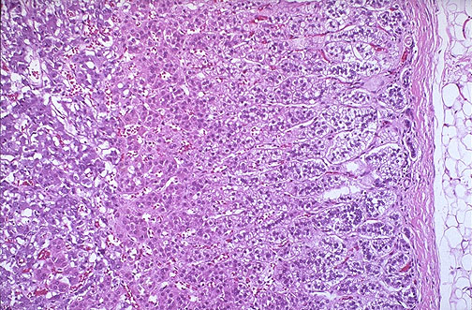
Adrenal Cortex
Zona Fasciculata
Glucocorticoids such as cortisol and cortisone
Hormone control:
ACTH
Target tissue:
Liver and general body cells
Hormone affects:
helps maintain blood pressure and cardiovascular function
helps slow the immune system's inflammatory response
helps balance the effects of insulin in breaking down sugar for energy
helps regulate the metabolism of proteins, carbohydrates, and fats
helps maintain proper arousal and sense of well-being

Slide 5
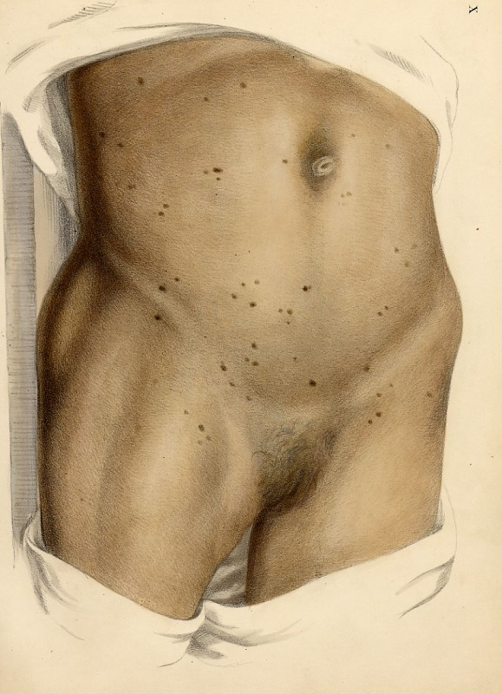
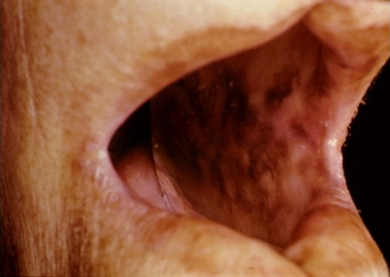
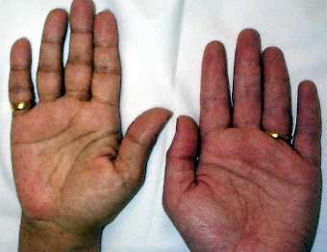
Adrenal Cortex
Hypo-secretion
Addison’s disease –
Failure to produce adequate levels of cortisol
Symptoms
chronic, worsening fatigue , muscle weakness ,
loss of appetite , weight loss , nausea , vomiting ,diarrhea
Other symptoms include
low blood pressure that falls further when standing,
causing dizziness or fainting
hyperpigmentation, or dark tanning;
this darkening of the skin is most visible on scars; skin folds;
pressure points such as the elbows, knees, knuckles, and toes; lips;
and mucous membranes

Slide 6
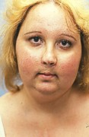
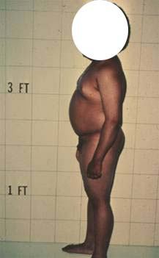
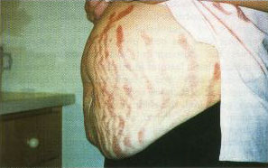
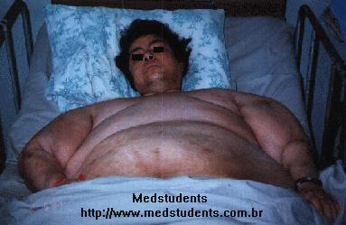
Adrenal Cortex
Hyper-secretion:
Cushing’s Syndrome
Symptoms
Upper body obesity, rounded face, increased fat around the neck, and thinning arms and legs. Children tend to be obese with slowed growth rates.
Skin, becomes fragile and thin. bruises easily and heals poorly. Purplish pink stretch marks may appear on the abdomen, thighs, buttocks, arms and breasts
Women usually have excess hair growth on their faces, necks, chests, abdomens, and thighs

Slide 7
Endocrine activity of the Adrenal Cortex
Zona glomerulosa
Mineralocorticoids such as Aldosterone
Hormonal control
renin-angiotensin pathway
permissive effect of ACTH
Target Tissue:
Principal cells of the DCT and collecting duct
Hormone Affects:
increases reabsorption of Na+ and water

Slide 8
Endocrine activity of the Adrenal Cortex
Hyper-secretion:
Aldosteronism:
Hypokalemia, increase in extracellular fluid and blood volume,and hyertension, may also have peroid of muscular paralysis
Hypo-secretion:
Addison’s disease
mineralocorticoids deficiency, death occurs in four days to two weeks if untreated

Slide 9
Endocrine activity of the Adrenal Cortex
Hormone Affects:
Elevated blood glucose levels
Reduction of protein stores in all body cells except the liver
increased plasma protein levels
promote lipolysis and beta oxidation of fat
Helps body recover from stress
Prevention of inflammation

Slide 10
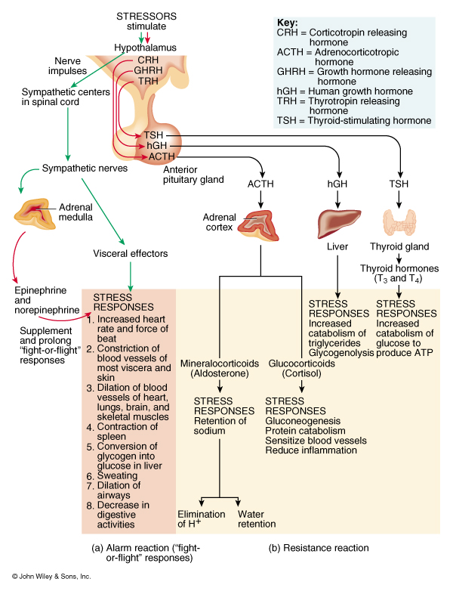
Overview of the interactions of hormones in response to stress

Slide 11
Endocrine activity of the Adrenal Cortex
Zona reticularis
Produces small anounts of androgens, mostly dehydroepiandrosterone (DHEA), DHEA may be converted into estrogens
Hormone Control:
Believed to be ACTH
Target tissue:
General body cells

Slide 12
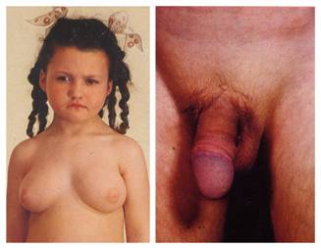
Endocrine activity of the Adrenal Cortex
DHEA: in normal physiology is responsible for energy levels and sex drive in both male and women.
Hyper-secretion may lead to Precocious puberty is appearance of secondary sexual characteristics in children, before the age of 8 years

Slide 13
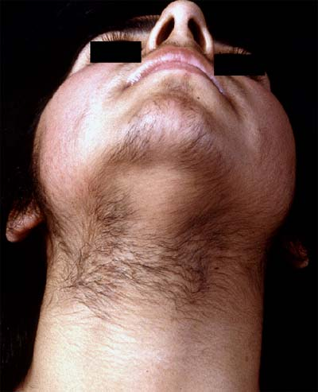
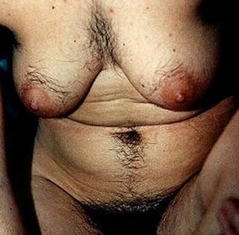
Adrenogenital Syndrome
In Adult females DHEA causes beard growth, deeper voice, masculine distribution of body hair (hirsutism), and growth of the clitoris to resemble a penis.

Slide 14
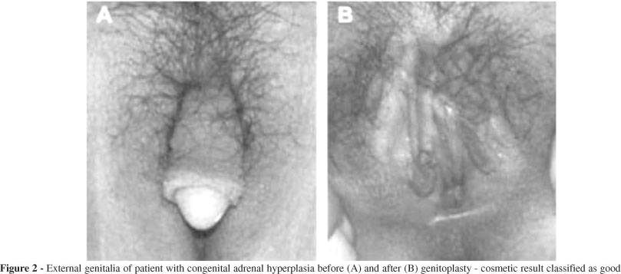

Slide 15
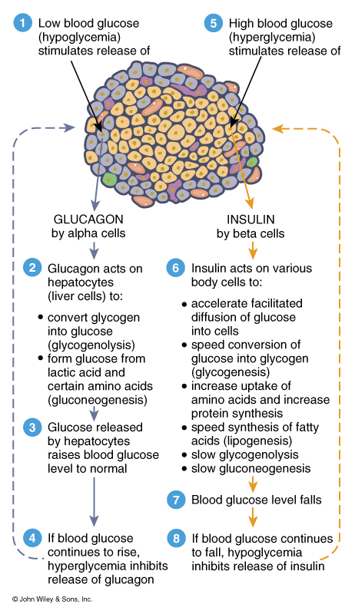
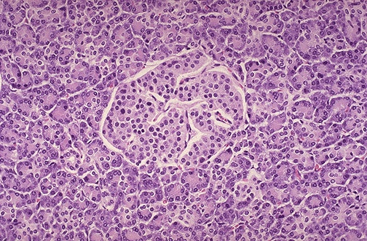
Interaction of 2 Pancreatic Hormones

Slide 16
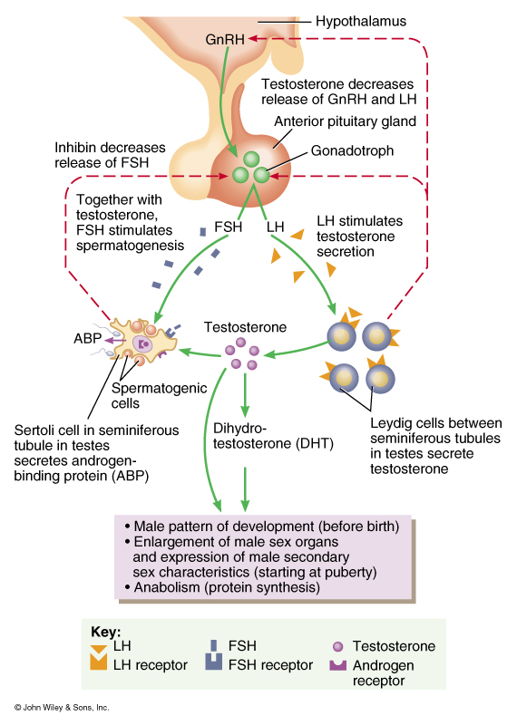
Hormonal control of the Male Reproductive System
Hypothalamus releases GnRH
GnRH stimulates the Gonadotrophs of the adenohypophysis to release FSH and LH
FSH stimulates Sertoli cells to secrete Androgen-binding protein (ABP) and stimulates spermatogenesis.

Slide 17
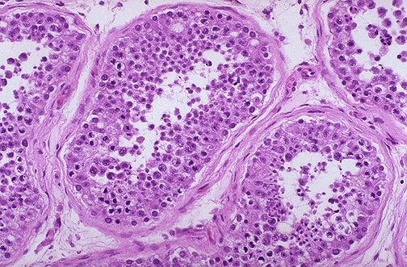
Hormonal control of the Male Reproductive System
LH stimulates the Leydig cells to secrete testosterone
Inhibin secreted by Sertoli cells controls the release of FSH by gonadotrophs

Slide 18
Male Menopause Myth or Reality? Andropause
At 40 testosterone levels begin to decline
Between 45 and 50 there is a steep drop in blood levels
By 80 50% of men have low testosterone levels
Signs and symptoms
1. Reduced sex drive
2. Infertility
3. Decrease spontaneous erections (during sleep)
4. Swollen/tender breast (gynecomastia)
5. Loss of body and pubic hair
6. Small or shrinking testes
7. Decrease in muscle mass
8. Hot flushes
9. Decrease energy, motivation, and self-confidence
10. Poor concentration and memory
11. sleep apnea
12. Mild anemia

Slide 19
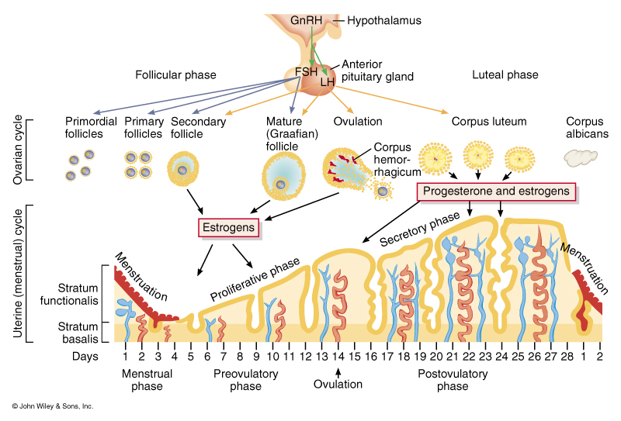
Action of Hormones on the Ovaries and Uterus

Slide 20
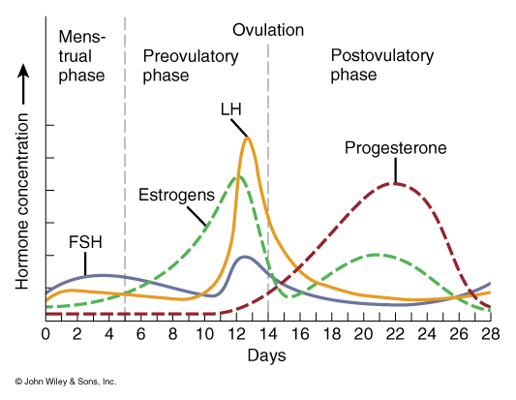
Cyclic Patterns of Hormone Production during the Ovarain Cycle

Slide 21
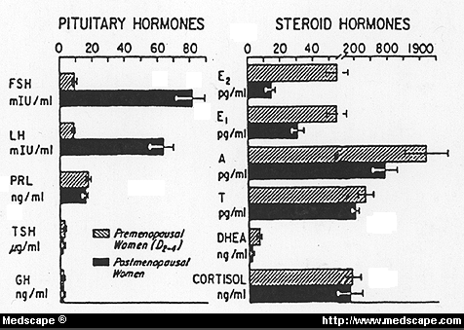
Hormonal Changes during Menopause
Blood levels of FSH increase
Blood levels of Inhibin decrease
Blood levels of estradiol decrease
Blood levels of progesterone decrease
Blood levels of DHEA decrease

Slide 22
Menopause
The degree to which each woman’s body responds to these normal hormonal changes varies.
25% of women do not have any problems with menopause and manage the transition without assistance
50% of women experience some menopausal symptoms, varying from mild to moderate
25% of women have more severe problems
Common Menopausal Symptoms:;
1. Hot flushes (last 30sec to 5min)
2. Menstrual irregularities
3. Sleep disturbances
4. Genital changes
5. Urinary problems
6. Joint/muscle aches and pain
7. Skin /hair changes
8. Neurological Brain function changes

Slide 23
Menopause
Positive action to decrease symptoms
1. Eat a well balanced diet
2. Exercise regularly
3. Stress management (Tai chi, yoga, meditation, relaxation)
4. Making sex comfortable (water based lubricants, vaginal hormone therapy)
5. Pelvic floor exercises
6. Trial hormone replacement therapy
7. Quit smoking

